Slide 1
The Generator Module
This section will introduce you the generator simulation module.

Slide 2
Generator Module
Designed to model distributed energy resource (DER). Sometimes also referred as distributed generation.
DER is defined as a small-scale electric generator located next to and connected to the load being served either with or without an electric grid interconnection.
Notes:
Note: make sure to stress that this is how we at the lab are treating distributed resources

Slide 3
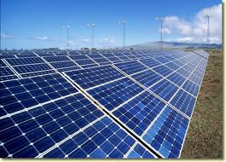
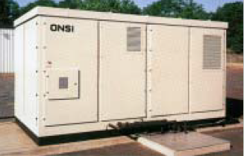
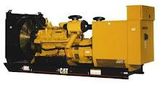
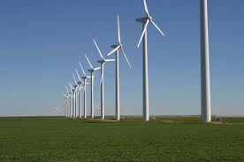
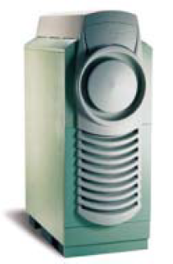
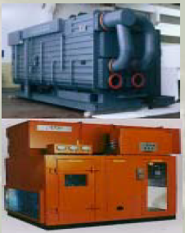
DER Portfolio Examples
Diesel Generator
Photovoltaic
Fuel Cell
Wind
Thermally activated technologies
Microturbines

Slide 4
Generator Module Objects
Includes
  Solar Panels
  Inverters
  Wind Turbines
  Diesel Gen-sets
  Energy Storage / Batteries
In development and still considered experimental
Future development will include standard governor / exciter type controls, Combined Heat and Power (CHP) for microgrid work

Slide 5
How does it work?
Modeled as “negative loads”
  Most are treated as multi-state, voltage dependent current injections
Components connect through meters, triplex_meters, or inverters to power flow
Control algorithms can be explicitly written into generator code or included from another object

Slide 6
Solar Object
Optimal tracking exists
Modeled as an array rather than individual cells or strings
Temperature de-rating modeled.
All other losses due to soiling, wiring mismatch accounted for.
Must have inverter as its parent. DC networks are not currently supported
Power flow sees it as a current injection and negative load
object solar {
name sol_inv_B_2_645;
generator_mode SUPPLY_DRIVEN;
generator_status ONLINE;
panel_type SINGLE_CRYSTAL_SILICON;
efficiency 0.2;
area 450;
};

Slide 7
Solar Object
Fixed axis PV object implemented in version 2.3
Needed for most of the residential PV simulation or analysis
User can specify the tilt needed or select a default which is often the latitude of the region selected
object solar {
name trip_solar;
phases AS;
parent trip_inv;
area 29.6296 m^2;
tilt_angle 50.0;
efficiency 0.135;
orientation_azimuth 25.0;
orientation FIXED_AXIS;
};

Slide 8
Inverter Object
Converts DC power to AC power and vice versa
All the dc power generating distributed resources should have inverter as its parent object.
Constant pf mode allows the user to set any power factor to regulate the reactive power within the specified inverter rating).
object inverter {
name inv_B_2_645;
phases BS;
generator_mode CONSTANT_PF;
generator_status ONLINE;
inverter_type PWM;
power_factor 1.0;
};

Slide 9
Inverter Object
Multi-point efficiency models are available in version 2.3. Includes only the major inverter types for now.
Various four quadrant control modes such as constant voltage, constant PQ, reactive power mode, volt/var control mode will be available for use in version 2.3

Slide 10
Solar-Inverter System Implementation
Inverter parents to either triplex- meter or meter
object inverter {
name inv_B_2_645;
phases BS;
generator_mode CONSTANT_PF;
generator_status ONLINE;
inverter_type PWM;
power_factor 1.0;
object solar {
name sol_inv_B_2_645;
generator_mode SUPPLY_DRIVEN;
generator_status ONLINE;
panel_type SINGLE_CRYSTAL_SILICON;
efficiency 0.2;
area 450;
};
}

Slide 11
Wind Turbines
Another major source of renewable energy
Rapidly increasing its penetration at the bulk generation level
Smaller, distributed wind turbines are still rare. No specific interconnection requirements exists for smaller wind turbines

Slide 12
Wind Turbine Object
Parents to triplex_meter or meter
User can choose from certain manufacturer wind turbine models or define a user specified model
COP curves are defined for above specified manufacturer models. User has the flexibility to specify relevant values to calculate their COP curves.
Currently only constant power is the tested mode.
Both induction and synchronous types of wind turbines can be modeled.
object windturb_dg {
name test_wdg;
phases "ABCN";
Gen_status ONLINE;
Gen_type SYNCHRONOUS;
Gen_mode CONSTANTP;
Turbine_Model VESTAS_V82;
}

Slide 13
Diesel Generators
A diesel engine takes in just air, compresses it and then injects fuel into the compressed air. The heat of the compressed air lights the fuel spontaneously.
Diesel engines use direct fuel injection
Diesel engine has no spark plug
Advantages
Very simple design also simple implementation
Low fuel cost
Quickly started and put on load
Occupy less space
Capital cost is less
High efficiency of energy conversion from fuel to electricity
Easier lubrication system
Disadvantages
High operating cost
High maintenance and lubrication cost
Noise problem
Relatively high emission

Slide 14
Diesel Generators
object diesel_dg{
enumeration Gen_mode; // CONSTANTPQ
enumeration Gen_status; // ONLINE
enumeration Gen_type; // SYNCHRONOUS
set phases; //AS
double cylinders; // Total number of cylinders in a diesel engine
double stroke; //category of internal combustion engines
double pressure;
double speed [1/min];//speed of an engine
double torque [N]; //Net brake load
double time_operation [min];
double fuel [kg]; // fuel consumption
double w_coolingwater [kg]; // weight of cooling water supplied per minute
double inlet_temperature [degC] //Inlet temperature of cooling water in degC
double outlet_temperature [degC]; // outlet temperature of cooling water in degC
double air_fuel [kg];// Air used per kg fuel
double room_temperature [degC];
double exhaust_temperature [degC];
double cylinder_length [m];
double cylinder_radius [m]
double brake_diameter [m];
double calotific_fuel [kJ/kg];
double steam_exhaust [kg]; //steam formed per kg of fuel in the exhaust
double specific_heat_steam [kJ/kg/K]; //specific heat of steam in exhaust
double specific_heat_dry [kJ/kg/K]; //specific heat of dry exhaust gases
};
Notes:
Mention abt its use in CHP modeling

Slide 15
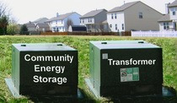
Battery Storage
Enhancement of distributed / renewable generation support
Incentives are being provided by government and utilities
Reduced equipment costs / deferral of system upgrades
Improved reliability and temporary islanding support
Peak shaving / congestion management
Provides power directly to the load
Load response to market signals
Reduced system losses
Power quality control
Local voltage control
www.aeptechcentral.com
Notes:
Various battery types, Li-ion, NaS types; internal battery model which exists,

Slide 16
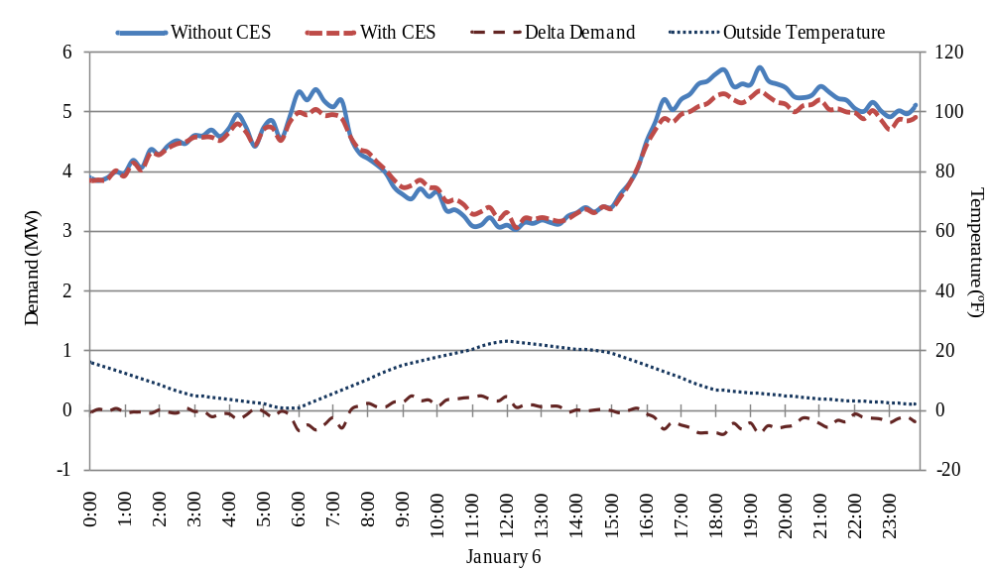
Example Analysis
Average Reduction: 158 kW
Peak Reduction: 347 kW
Average Reduction: 156 kW
Peak Reduction: 379kW
Substation Load on a Cold Day With and Without CES
Notes:
Small taxonomy feeder

Slide 17
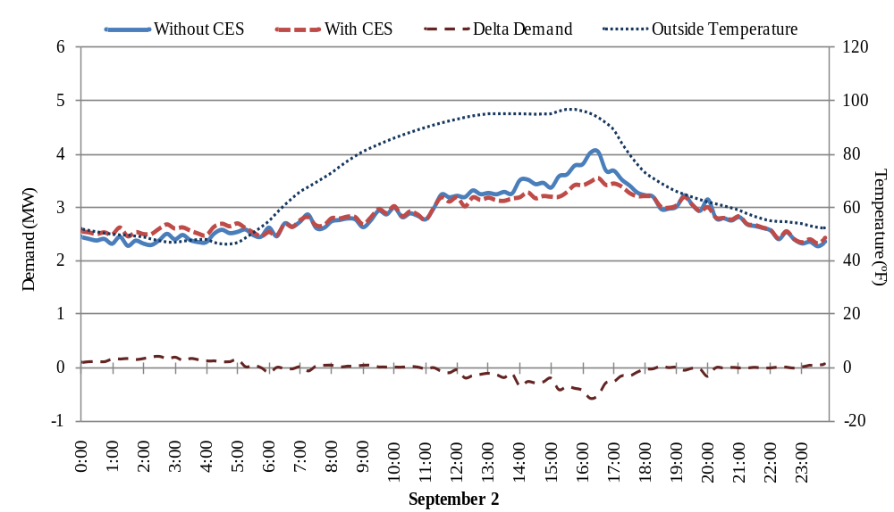
Example Analysis
Average Reduction: 207 kW
Peak Reduction: 583 kW
Substation Load on a Warm Day With and Without CES

Slide 18
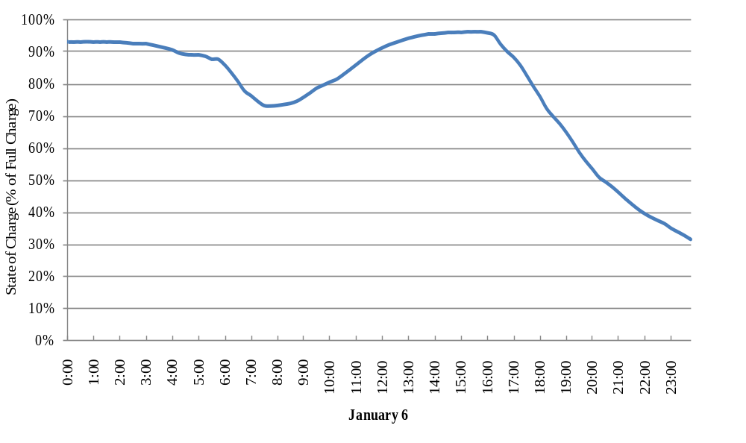
Example Analysis
Beginning of three day cold spell. This value continues to less than 10% before recovering for the morning peak.
Energy Available in Entire CES System on a Cold Day

Slide 19
Effects of Sensitivity on Losses and Energy Consumption
Equates to only 19.1 kWh on a 156,573 kWh feeder
Sensitivity | 0.5 | 1.0 | 1.8
Real Loss Reduction (%) | 1.41 | 2.15 | 2.89
Reactive Loss Reduction (%) | 1.46 | 2.22 | 2.99
Increase in Energy Consumption (kWh) | 53.7 | 112.1 | 434
Total Days Used | 262 | 313 | 359
Highest Winter DoD (%) | 49.0 | 91.5 | 100*
Highest Summer DoD (%) | 41.5 | 43.7 | 60.6
Can reduction of losses really be considered a benefit of energy storage when it only equates to 0.01% of total energy used?
Does it offset the increased energy consumption?

Slide 20
Exercise 4.4.1
1. Simulate a simple modified IEEE 13-node test system populated with residential houses for a summer day
a) Measure the electric power at the substation end
b) Measure the losses at the distribution XFMR end
2. Simulate a simple modified IEEE 13-node test system populated with residential houses for a winter day
a) Measure the electric power at the substation end
b) Measure the losses at the distribution XFMR end

Slide 21
Exercise 4.4.2
1. Simulate the IEEE-13 node test system pre-populated with residential houses and PV objects for a summer day
Measure the electric power at the substation end
b) Measure the losses at the distribution XFMR end
2. Simulate the IEEE-13 node test system pre-populated with residential houses and PV objects for a winter day
Measure the electric power at the substation end
b) Measure the losses at the distribution XFMR end

Slide 22
Exercise 4.4.3
Compare and analyze the results from exercise 4.4.1- 1a, 1b with 2a,2b
Compare and analyze the results from exercise 4.4.1-1a, 1b with exercise 4.4.2-1a, 1b
Compare and analyze the results from exercise 4.4.1-2a, 2b with exercise 4.4.2-2a, 2b

